Slide 1

DAYANANDA SAGAR UNIVERSITY
SCHOOL OF ENGINEERING
Department of Computer Science and Technology
Major Project Phase-I
<TITLE OF THE PROJECT IN ALL CAPS>
Under the Supervision
Dr./Prof. <Guide Name>
‹#›
Presented By:
Student Name (Student USN)
Student Name (Student USN)
Student Name (Student USN)
Student Name (Student USN)
Notes:
Title of the project
CSE Dept., SET-Jain University
‹#›

Slide 2
Overview
Abstract
Problem Statement
Introduction
Social/Environmental Impact (If applicable)
State of the Art work
Design
Deliverables
References
*
Dept of CSE., SOE-Dayananda Sagar University
‹#› of 12

Slide 3
Abstract
Give only key points
Do not write paragraph
Why this work
What you plan to do
How will you do-Approach
What we can expect as result
*
Dept of CSE., SOE-Dayananda Sagar University
‹#› of 12

Slide 4
Problem Statement
A problem statement is usually one or two sentences to explain the problem your process improvement project will address.
A problem statement should include a user, a need/ pain point and a goal/ reason.
Precise definition of the problem
Eg:
Problem: “Going to the video store requires fighting traffic, wandering the aisles, and waiting in long lines just to get a single movie.”
Solution: Include the technology
*
Dept of CSE., SOE-Dayananda Sagar University
‹#› of 12

Slide 5
Introduction
What is the current status
What you plan to do
Scope of the project
Assumptions
*
Dept of CSE., SOE-Dayananda Sagar University
‹#› of 12

Slide 6
Social/Environmental/ Technical Impact
State in one or two sentences
Can use pics/images to explain
*
Dept of CSE., SOE-Dayananda Sagar University
‹#› of 12

Slide 7
State of the Art-work
Literature survey
Do not copy paragraphs from papers or your report
Can include a table like below( this is in general: include or exclude columns as per guide instructions)
Author’s Name/ Paper Title | Conference/Journal Name and year | Technology/ Design | Results shared by author | What you infer
*
Dept of CSE., SOE-Dayananda Sagar University
‹#› of 12

Slide 8
Design
A high-level design will include data flows, flowcharts, data structures:
System architecture
Database design
Brief mention of all the platforms, systems, services, and processes the product would depend on
Brief description of relationships between the modules and system features
*
Dept of CSE., SOE-Dayananda Sagar University
‹#› of 12

Slide 9
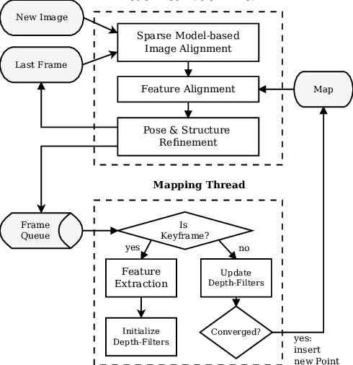
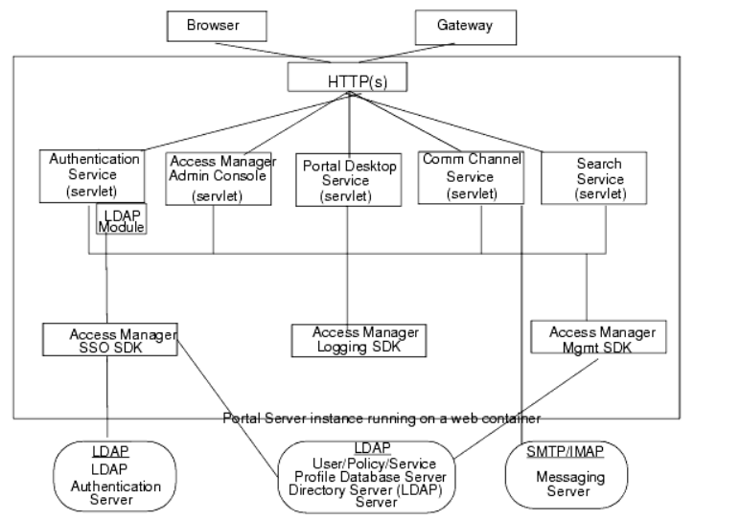
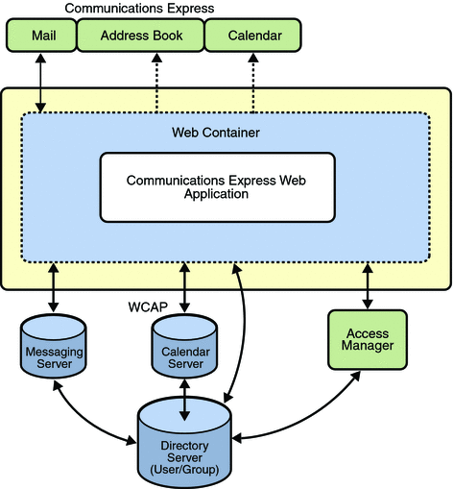
Design- few examples
*
Dept of CSE., SOE-Dayananda Sagar University
‹#› of 12

Slide 10
Design- Screen design
*
Dept of CSE., SOE-Dayananda Sagar University
‹#› of 12

Slide 11
Deliverables
At the end of project in 8th semester what output is expected
*
‹#› of 12
Dept of CSE., SOE-Dayananda Sagar University

Slide 12
References
List of all the papers that were referred as mentioned in the Literature survey section to be given in the IEEE format
*
Dept of CSE., SOE-Dayananda Sagar University
‹#› of 12

